Slide 1
Broadband ILD fNIRS Study Update
06/07/2024

Slide 2
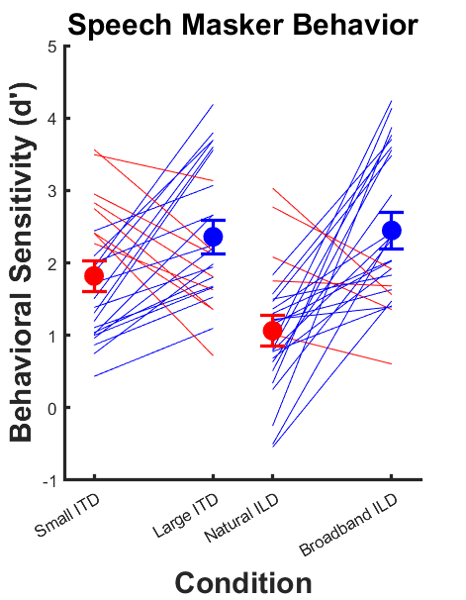
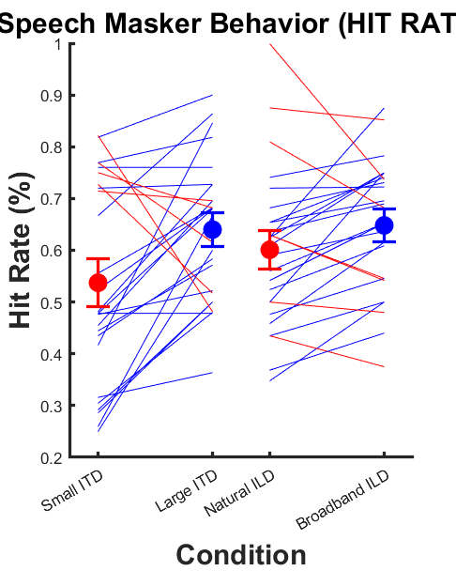
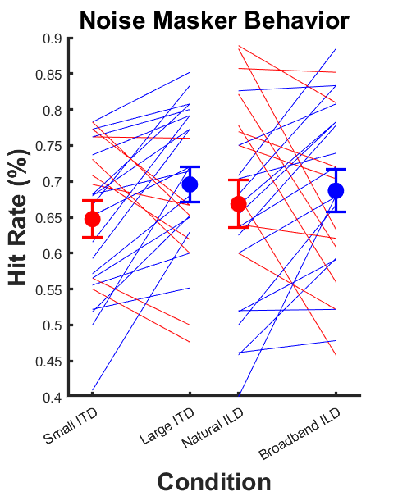
Behavior (n = 26)

Slide 3



Block averages by channel (PFC): Speech Masker

Slide 4



Block averages by channel (PFC cont): Speech Masker

Slide 5




Block averages by channel (STG Left): Speech Masker

Slide 6




Block averages by channel (STG Right): Speech Masker

Slide 7
STG, ipsi vs contra in each channel

Slide 8



Block averages by channel (PFC): Noise Masker

Slide 9



Block averages by channel (PFC cont): Noise Masker

Slide 10




Block averages by channel (STG Left): Noise Masker

Slide 11




Block averages by channel (STG Right): Noise Masker

Slide 12


Mean HbO topoplots
Speech masker
Noise masker

Slide 13


GLM topoplots
Speech masker
Noise masker

Slide 14


GLM topoplots (BH Corrected a la Eli)
Speech masker
Noise masker

Slide 15
GLM Channel by Channel, across subjects

Slide 16
Mixed Effects Model Analysis (Mean HbO)

Slide 17
Mixed Effects Model Analysis (Beta)

Slide 18
MILD2 stuff

